Slide 1
APOLOGETICS
IN ONE LESSON
almost
Ai1L.net
Lesson 12
Undesigned Coincidences in the Gospels

Slide 2
Walter

Slide 3
Mia

Slide 4
Harry

Slide 5
Aiden

Slide 6
Luna

Slide 7
Helen

Slide 8
Mildred

Slide 9
Mason

Slide 10
Dorothy

Slide 11
Donald

Slide 12
Male Names

Slide 13
Female Names

Slide 14
People Names (in the 1st century)

Slide 15
Number of Place Names
False
Gospels
Authentic
Gospels

Slide 16
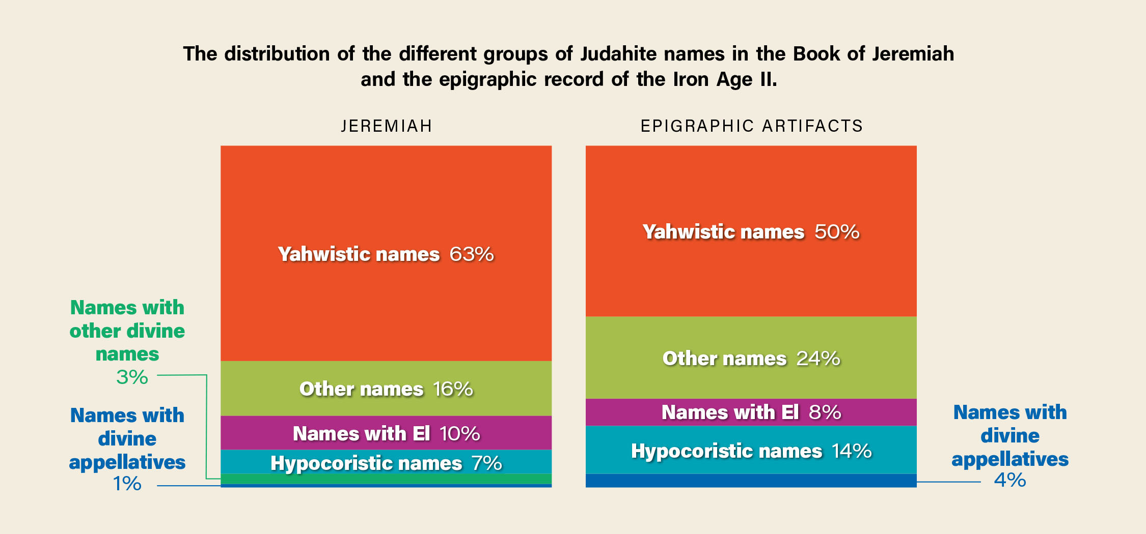

Slide 17
IDEA IN BRIEF
What?
Show that the Gospel accounts include coincidental details associated with eyewitness testimony
Why?
So that we can show that the Gospel accounts are unlikely to be fabricated
How?
By examining subtle (undesigned) facts that align across multiple Gospel accounts and fit like a puzzle

Slide 18
Why did Jesus wash the disciples' feet (read John 13:1-15)?
1

Slide 19
What “cup” is Jesus talking about in John 18:10-11?
2

Slide 20
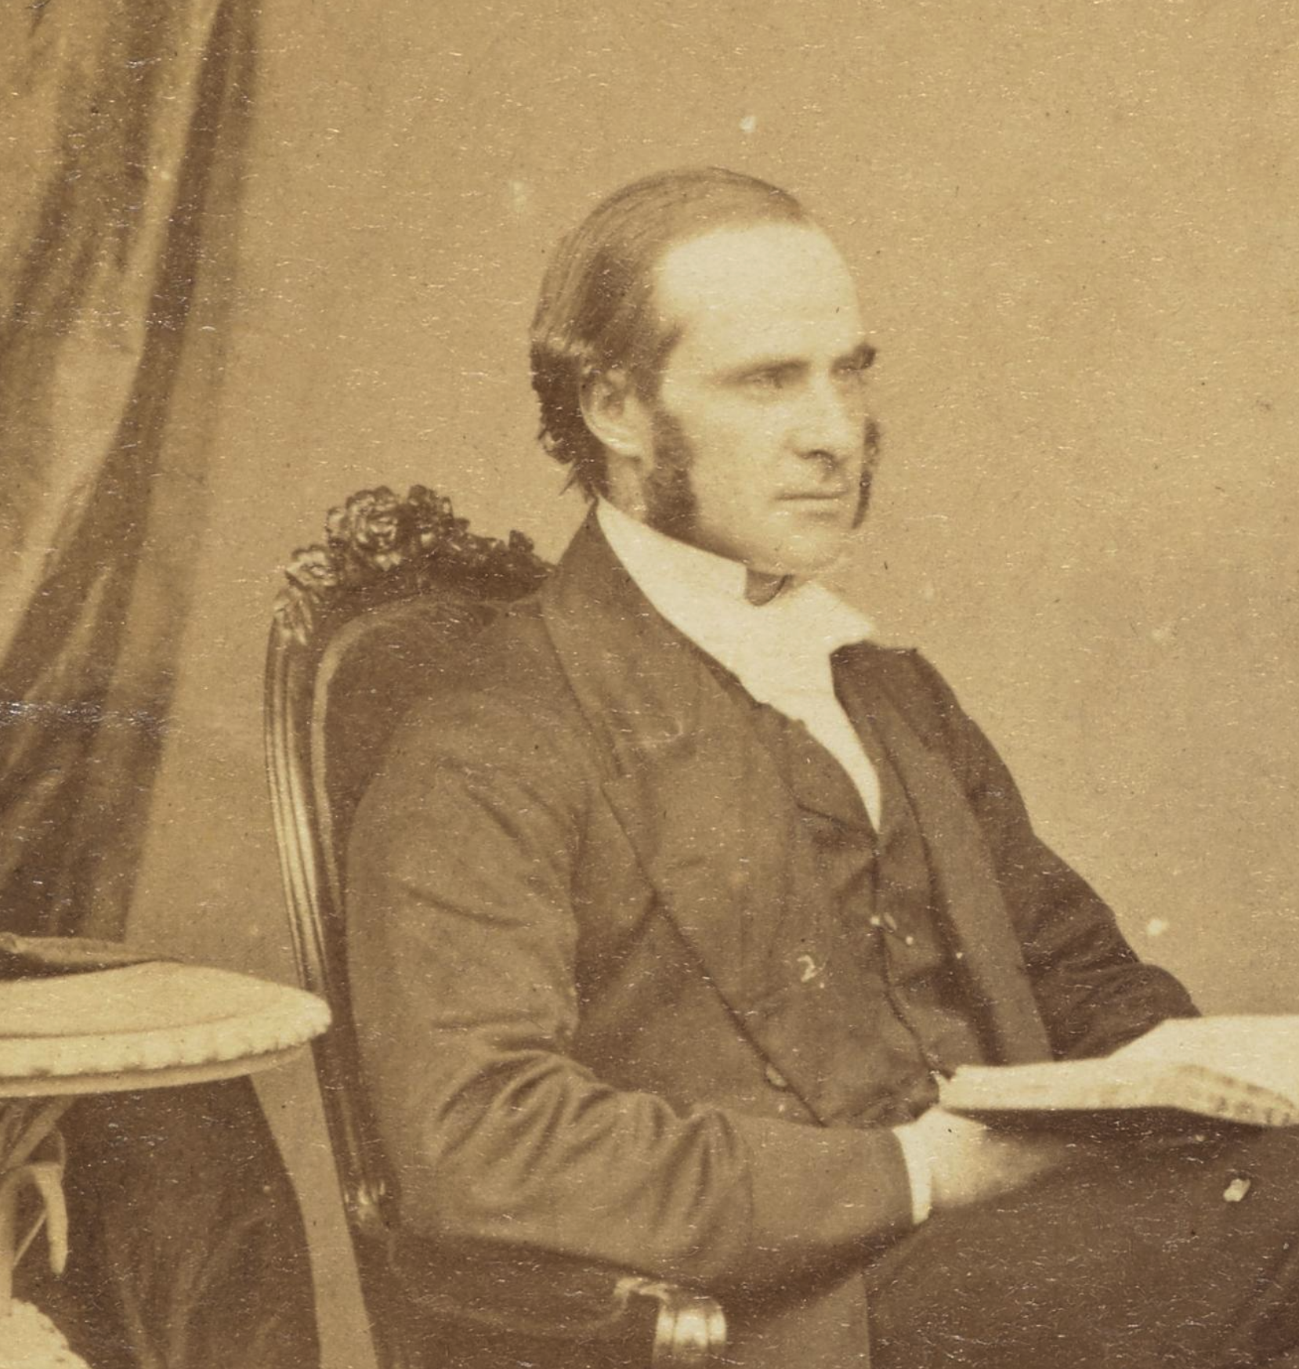
“﻿Undesignedness must be apparent in the coincidences, or they are not to the purpose.”
JAMES JOHN BLUNT Undesigned Coincidences in the New Testament, Acts and Josephus (page 2)

Slide 21

“﻿It is not necessary that any fact be proved by direct evidence. You may consider both direct evidence and circumstantial evidence as proof.”
INDIANA JURY INSTRUCTIONS Instruction No. 12.0100

Slide 22

“﻿ Circumstantial evidence … may have an advantage because it comes from several different sources, which can be used as a check on each other.”
CRIMINAL MODEL JURY INSTRUCTIONS 2.240 DIRECT AND CIRCUMSTANTIAL EVIDENCE

Slide 23
“﻿An undesigned coincidence is a notable connection between two or more accounts or texts that doesn’t seem to have been planned by the person or people giving the accounts.”
LYDIA MCGREW Hidden In Plain View

Slide 24
“﻿Despite their apparent independence, the items fit together like pieces of a puzzle.”
LYDIA MCGREW Hidden In Plain View

Slide 25
Jesus says that his servants will not fight (John 18:36). However, John also records that Jesus’ disciples fought with those that came to arrest him (John 18:10-11).
3

Slide 26
Why would Jesus repeatedly ask Peter “do you love me more than these” in John 21:15-17?
4

Slide 27
Why were “many coming and going” in Mark 6:30-31?
5

Slide 28
Jesus makes a point in Luke 22:25-27 that the one who serves is greater than the one who “reclines at the table.”
6

Slide 29
Jesus tells Pilate that he is the king. Why would Pilate want to let him go given that looks like an act of sedition?
7

Slide 30
Mark says that Joseph of Arimathea “took courage” to ask Pilate for the body. Why was he considered courageous?
8

Slide 31
Mark 6:7 says that Jesus sent out his disciples “two by two”. Why might this be significant?
9

Slide 32
Herod spoke to his servants about Jesus; how might Luke have found out about this conversation?
10

Slide 33
How did there just so happen to be a nearby tomb for Jesus?
11

Slide 34
Why did Jesus ask Philip where to find food in John 6:1-5?
12

Slide 35
Questions 5-8
John explaining the Synoptics
John
Synoptics (Matthew, Mark, Luke)
Questions 9-12
Synoptics explain each other
Questions 1-4
Synoptics explaining John

Slide 36
Key Takeaways
1
Circumstantial evidence is valid; and has the advantage of coming from different sources
2
The Gospels include many “undesigned coincidences” which are difficult to explain if they were made up
3
Differences between the Gospel accounts give support to them including independent accounts

